Slide 1


Sensors and Actuators
LÊ TRỌNG NHÂN
trongnhanle@hcmut.edu.vn
trongnhanle85@gmail.com

Slide 2
Content
Introduction to RS485
Modbus 4856 data format
Decode received array
Soil temperature and moisture

Slide 3
Part 0: Introduction to RS485

Slide 4
What is RS485?
“Recommended Standard” jointly published by Telecommunications Industry Association (TIA) and Electronic Industries Alliance (EIA).
Defines the electrical characteristics of interface circuits (line drivers/transmitters and receivers) used for serial communications over a multipoint network.

Slide 5
Why RS485?
Balanced interface → increases noise immunity and decreases emissions
Multipoint, bi-directional communication on a single pair of wires → lower cabling costs
Large differential signal, large common mode range → allows for communication over long distances and with large ground potential differences
Can achieve signaling rates up to 50 Mbps → suitable for a wide array of applications

Slide 6
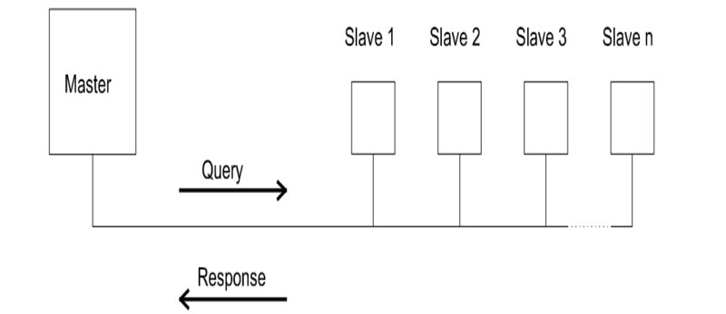
What is ModBus 485?
In a Modbus RS485 Network, communication begins when the master device sends a query to a connected slave.
Similar to local network using Ethernet, ModBus 485 is a local network for industrial sensors and actuators.

Slide 7
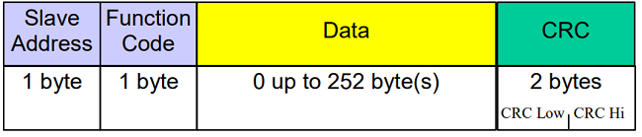
ModBus 485 Format
relay1_ON = [0, 6, 0, 0, 0, 255, 200, 91]
relay1_OFF = [0, 6, 0, 0, 0, 0, 136, 27]

Slide 8
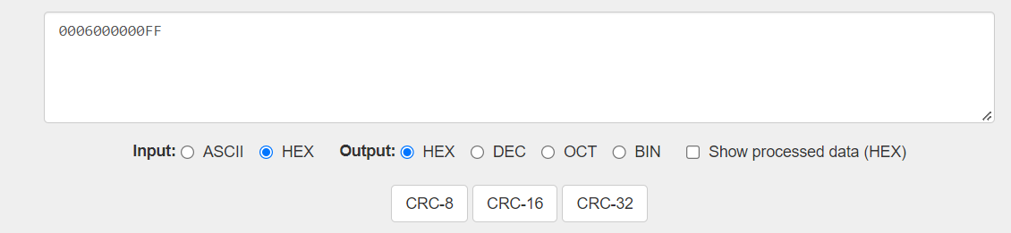
How to Calculate CRC?
https://crccalc.com/
relay1_ON = 0006000000FF

Slide 9
Soil Temperature and Moisture
soil_temperature =[1, 3, 0, 6, 0, 1, 100, 11]
soil_humidity = [1, 3, 0, 7, 0, 1, 53, 203]

Slide 10
Part 1: Implement Modbus 485

Slide 11
Step 1
Create a new python file for the project:
physical.py

Slide 12
Step 2
Install the pyserial package
pip install pyserial
Import the package to the project
print("Sensors and Actuators") import time import serial.tools.list_ports

Slide 13
Step 3
Find the comport name (in Windows)
def getPort(): ports = serial.tools.list_ports.comports() N = len(ports) commPort = "None" for i in range(0, N): port = ports[i] strPort = str(port) if "USB Serial" in strPort: splitPort = strPort.split(" ") commPort = (splitPort[0]) return commPort

Slide 14
Step 4: Open the COM port
portName = getPort() print(portName) if portName != "None": ser = serial.Serial(port=portName, baudrate=9600)

Slide 15
Step 5: Send command to Actuators
relay1_ON = [0, 6, 0, 0, 0, 255, 200, 91] relay1_OFF = [0, 6, 0, 0, 0, 0, 136, 27] def setDevice1(state): if state == True: ser.write(relay1_ON) else: ser.write(relay1_OFF)

Slide 16
Step 6: Extend for the second Actuator
relay2_ON = [15, 6, 0, 0, 0, 255, 200, 164] relay2_OFF = [15, 6, 0, 0, 0, 0, 136, 228] def setDevice2(state): if state == True: ser.write(relay2_ON) else: ser.write(relay2_OFF)

Slide 17
Step 7: Receive Response
def serial_read_data(ser): bytesToRead = ser.inWaiting() if bytesToRead > 0: out = ser.read(bytesToRead) data_array = [b for b in out] print(data_array) if len(data_array) >= 7: array_size = len(data_array) value = data_array[array_size - 4] * 256 + data_array[array_size - 3] return value else: return -1 return 0

Slide 18
Step 8: Read Soil Temperature
soil_temperature =[1, 3, 0, 6, 0, 1, 100, 11] def readTemperature(): serial_read_data(ser) ser.write(soil_temperature) time.sleep(1) return serial_read_data(ser)

Slide 19
Step 9: Read Soil Moisture
soil_moisture = [1, 3, 0, 7, 0, 1, 53, 203] def readMoisture(): serial_read_data(ser) ser.write(soil_moisture) time.sleep(1) return serial_read_data(ser)

Slide 20
Step 10: Project Integration

